Slide 1



CENTRAL CAR POLICY
TOLGA ÇOBANOĞLU

Slide 2
CONTENT
-PROBLEM DESCRIPTION
-TO BE VICTIMIZED WAYS
-HYPOTHESIS
-SCOPE
-SOLUTION PROPOSAL
-DIFFERENCE WITH THE EXIST
-WHAT IS CENTRAL CAR POLICY?
-SYSTEM OVERVIEW
-SYSTEM ARCHITECTURE
-SYSTEM ACTIVITIES
-SYSTEM SCENARIO
-PROJECT FEATURES
-USER INTERFACE
-POTENTIAL RISKS

Slide 3
PROBLEM DESCRIPTION
Problem is that the buyer is victimized in the second-hand vehicle market, which we have encountered a lot both on the internet and on social media in Turkey in recent years.
The seller victimizes the buyer in different ways.

Slide 4
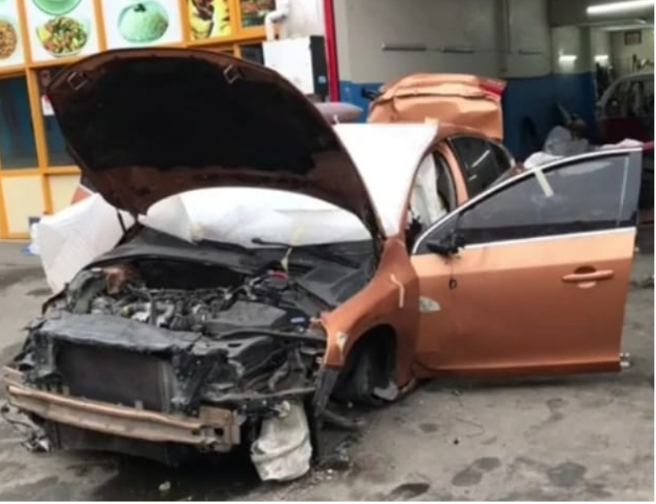
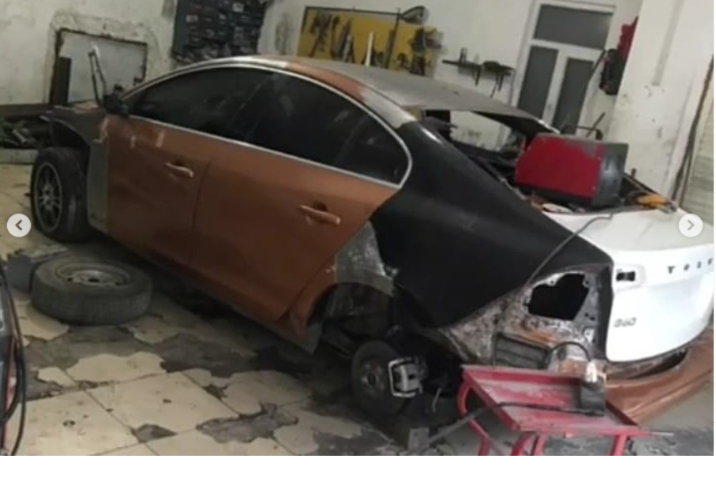
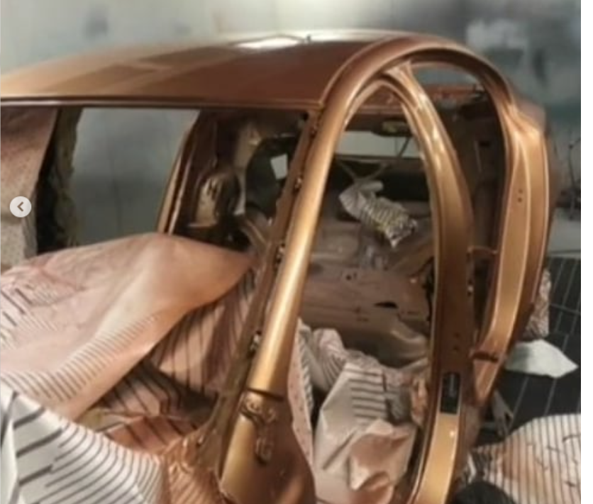
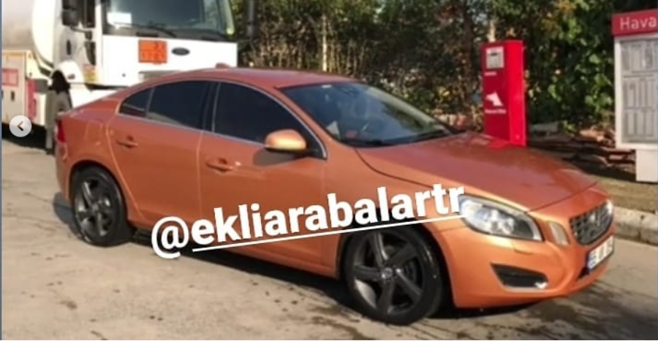
TO BE VICTIMIZED WAYS
- When the user buys the car which is without an accident, the entire body of the car may be completely changed.

Slide 5
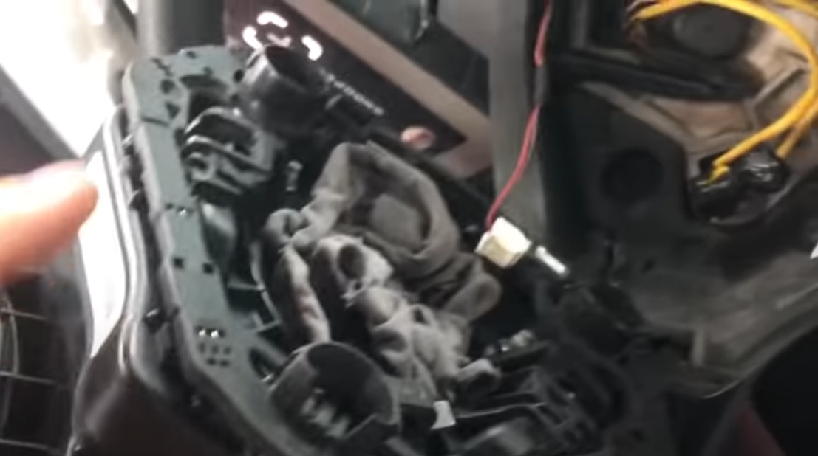
TO BE VICTIMIZED WAYS
- In the car that you bought because it was repaired after an accident, cloth pieces and cables may be connected with resistance instead of the airbag.

Slide 6
TO BE VICTIMIZED WAYS
In some cases, these problems in cars can be discovered by the buyer, declared by the seller, or before the purchase, the appraisals may discover some situations, but it is not possible to discover them.
But in scenarios where these situations do not occur, no individual deserves to buy or drive a vehicle with a welded body or without an airbag.

Slide 7
HYPOTHESIS
-With a policy that will be made compulsory throughout the country, a record should be kept of which vehicle and which transactions are carried out by the institution, regardless of the institution.

Slide 8
SCOPE
- Reducing the probability of the buyer in the secondhand car market to be victimized to a lower rate

Slide 9
SOLUTION PROPOSAL
Designing a system where institutions (as expertise and service) can register their vehicles through a single system, where the buyer who wants to learn about the vehicle can access the vehicle details endlessly and free of charge.
I will call it central car policy.

Slide 10
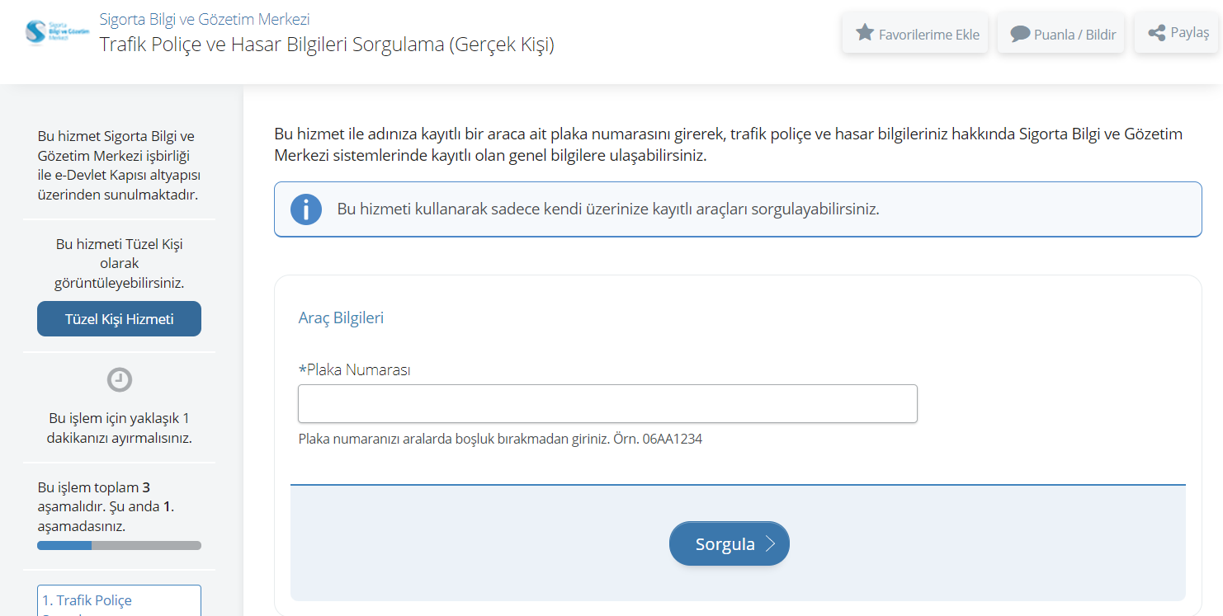
DIFFERENCE WITH THE EXIST
There are some different ways to learn details of car,
Firstly, you can use e-devlet platform to get information about your traffic policy and damage information.
There is one necessary rule, you can only use this if you own the car.

Slide 11
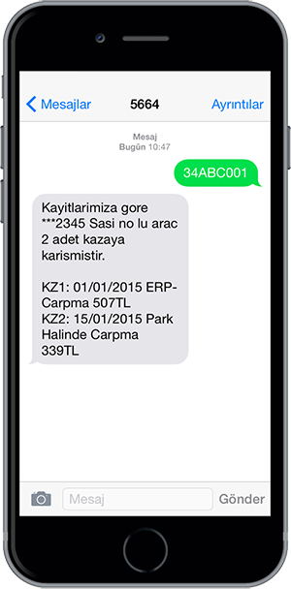
DIFFERENCE WITH THE EXIST
You can make a query different way with using sms service as «5664».
It presents different choice about query like details of accidents or accidents involving the vehicle, the amount of damage paid etc.
Disadvantage of the this system you have to pay every per query 11Turkish Liras and it does not show real things. These messages are only the accident charges reported to the insurance.
If the user does not want the boiler to appear in the damage costs, she/he can have it done in the industry and deceive these records.

Slide 12
WHAT IS CENTRAL CAR POLICY ?
It works in the scenario where it is compulsory to use it as an expertise or service, regardless of the institution.
There are some frauds in the car market and they are applied to fight them.
When it becomes mandatory, every change made to the car, such as headlight replacement, battery change, must be added to the system by the service and as a result, the information of that car will be updated.
From the other side, it is possible to model different data from the retention of information in this system. Some of them are the fees charged by the service and the fees incurred by other services, whether it shows all the revenues earned as taxes, and many other data.

Slide 13
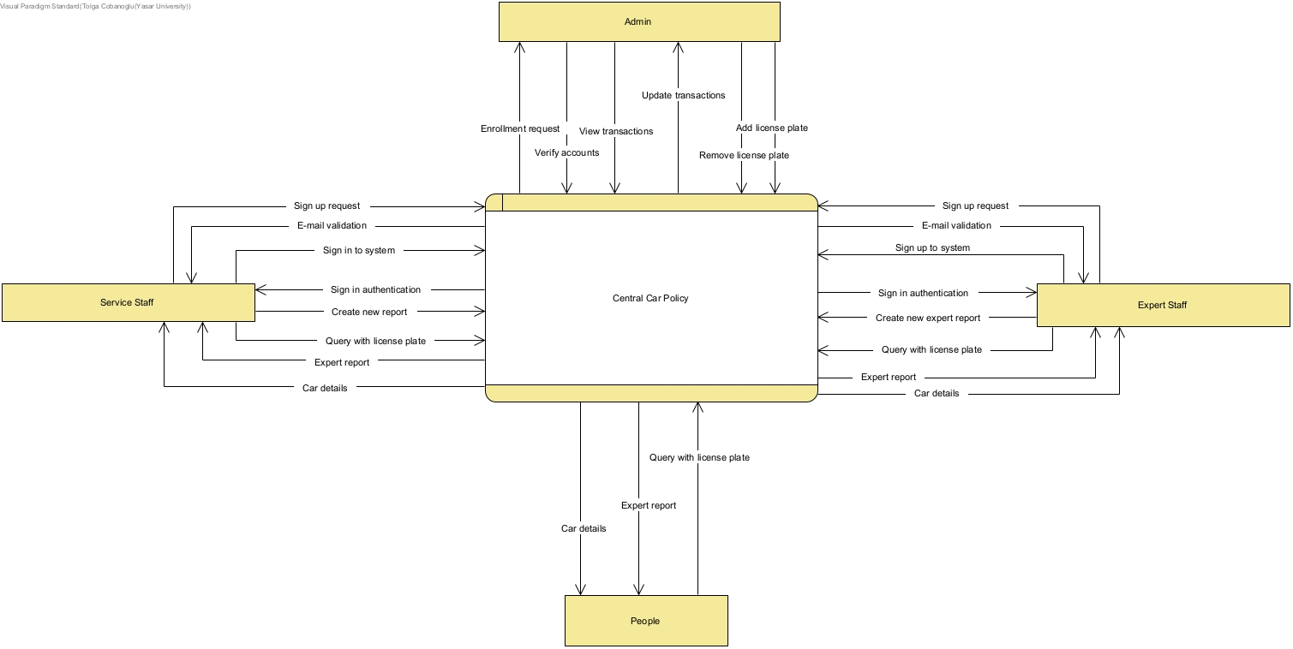
SYSTEM OVERVIEW
It appeals to four different users, these are people, service, expertise and government.

Slide 14
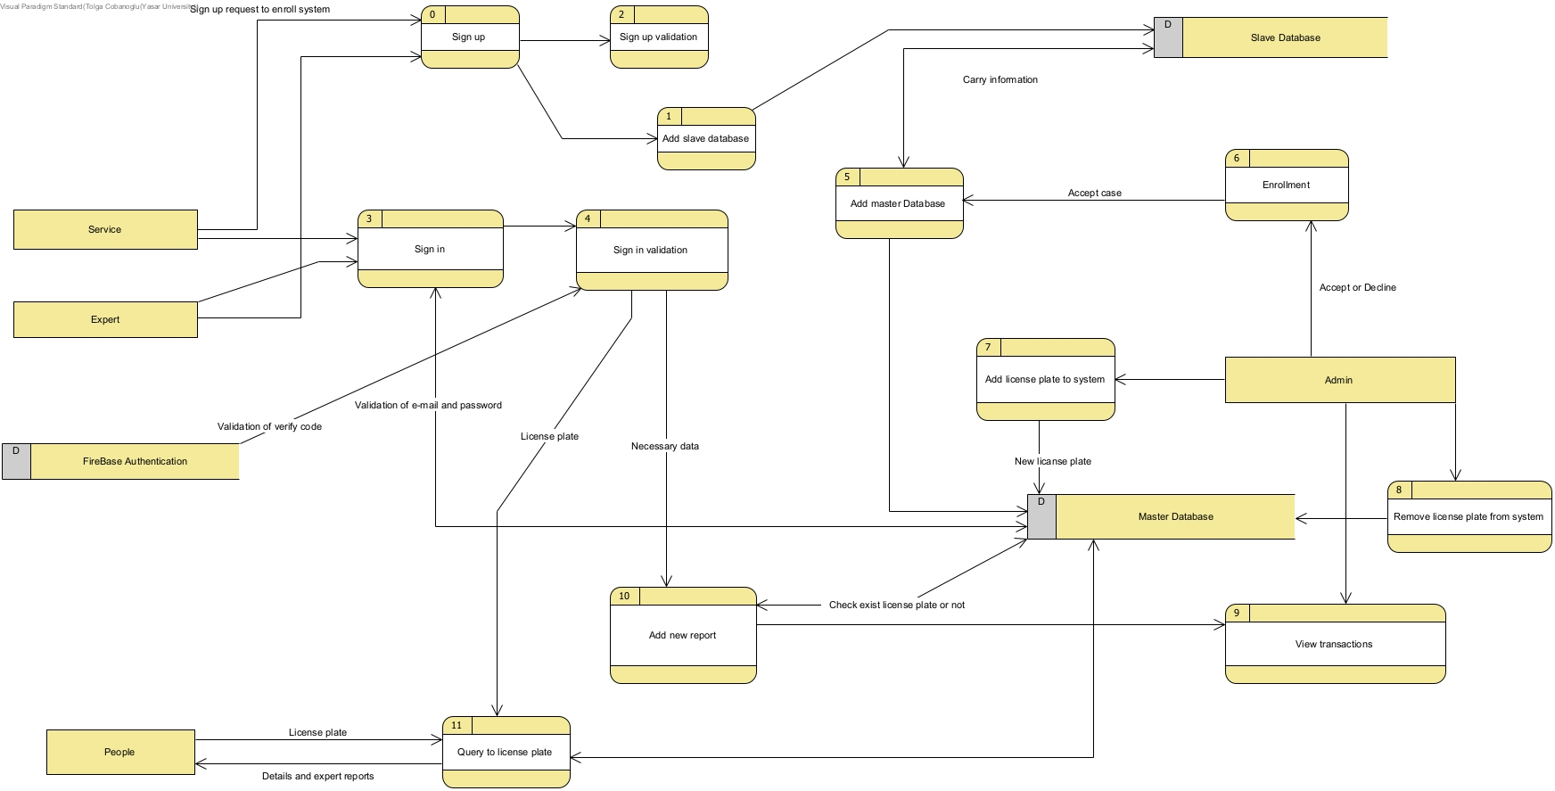
SYSTEM ARCHITECTURE
The diagram in the picture shows the processes that specific entities can do.

Slide 15
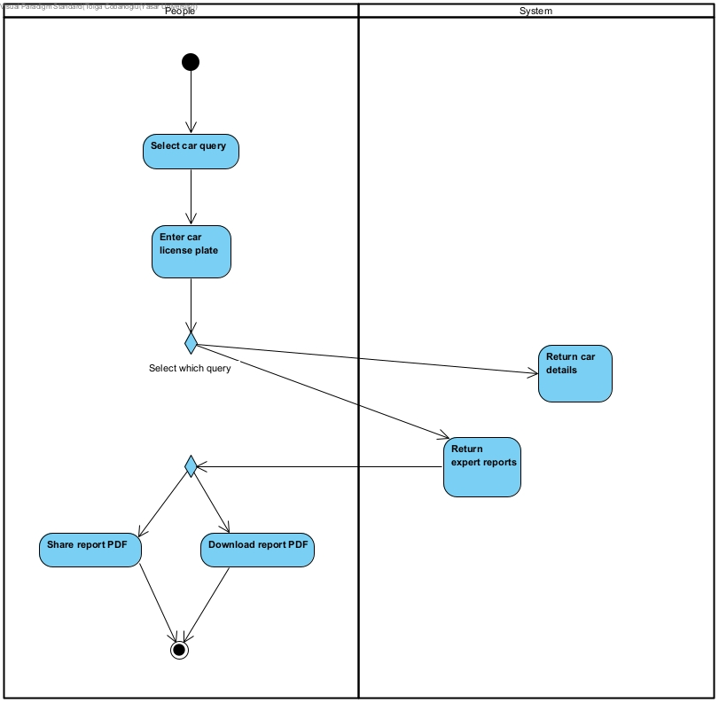
System actıvıtıes
-Activities for People
People can make query with car license plate, after that system return details of car and expert reports.

Slide 16
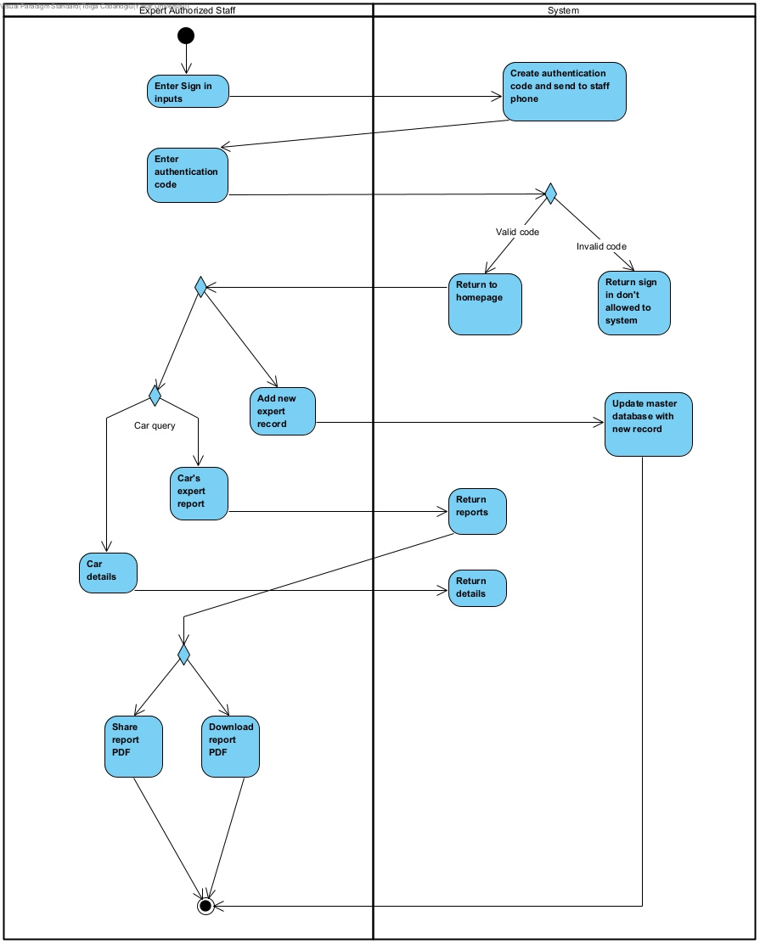
SYSTEM ACTIVITIES
-Activities for Expert Staff
They can do after the authenticated sign in process, add new record and make a car query.

Slide 17
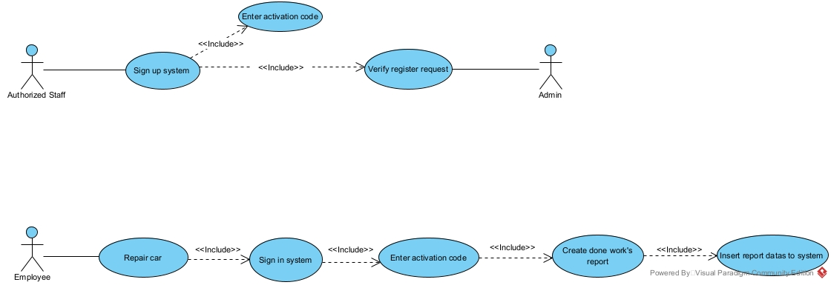
System scenarıo
Example for Service Client Use Case Scenario

Slide 18
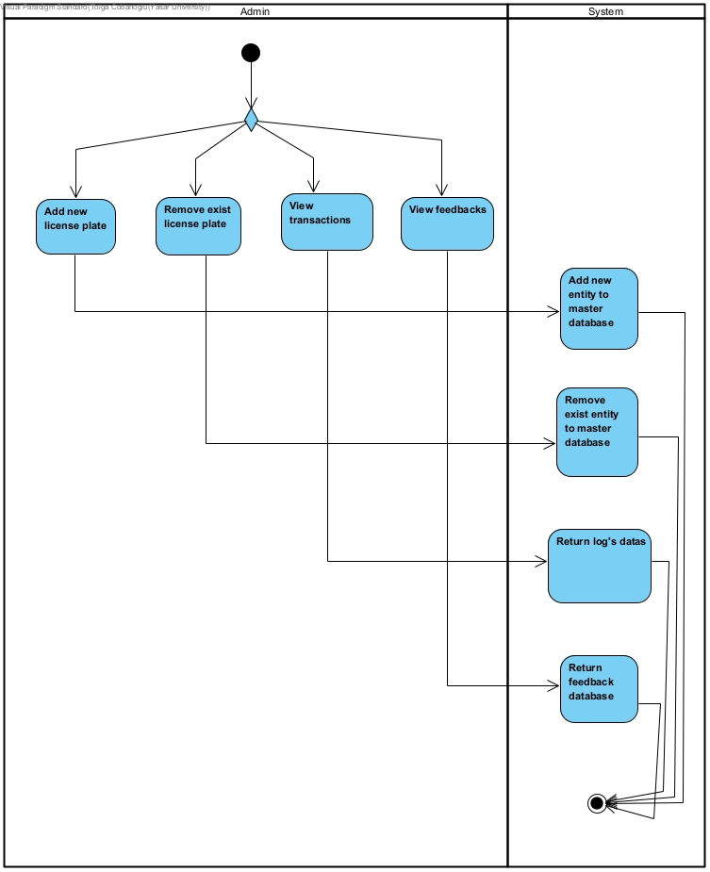
SYSTEM ACTIVITIES
-Activities for Admin
Admin means government or any authorized staff or organisation.
They can add and remove license plate, view transactions and feedbacks and accept or decline enrollments of business.

Slide 19
Some PROJECT FEATURES WITH REQUIREMENTS
- Authentication for business clients. (Security Non-Functional Requirements)
- Data hold be form of encrypted with encrypt algorithm and hashed by SHA256. (Data Integrity Non-Functional Requirements)

Slide 20
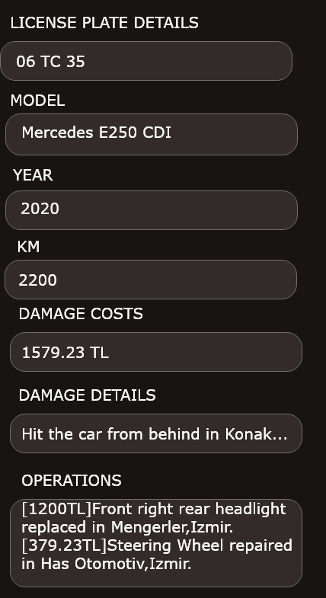
USER INTERFACE
Screen of query’s result page
It includes details of car such as model, year, kilometers, damage costs and operations.

Slide 21
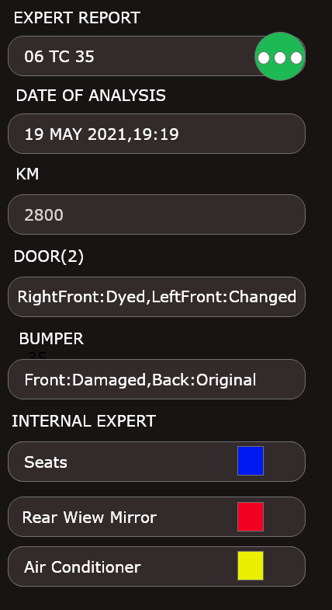
USER INTERFACE
Screen of query’s result page
It includes expert reports details.

Slide 22
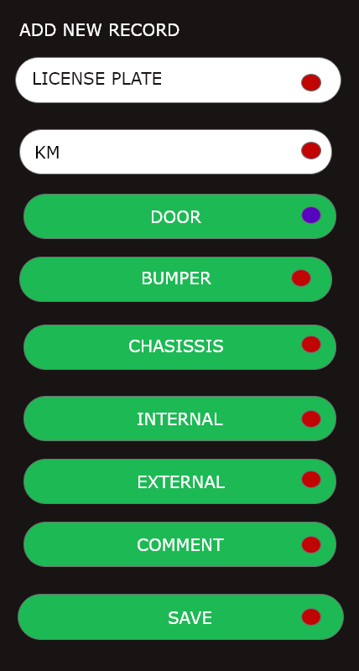
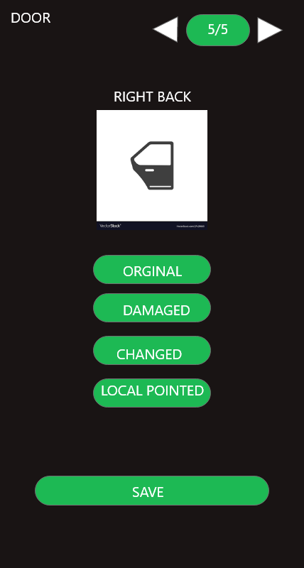
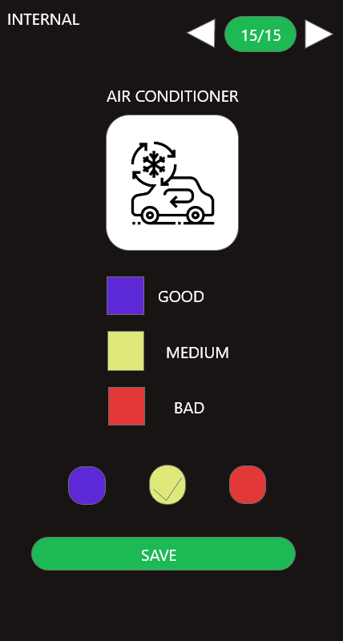
USER INTERFACE
At the same time, the business forms of these services and expertise will be shaped according to the standard given in practice.

Slide 23
Some potentıal rısks
- Inexperienced with Firebase service as Authentication and Real Time Database.
- Inexperinced with Android programming.
- Communication between clients as Admin-Business and People Client.

Slide 24

THANKS FOR LISTENING

Slide 25


